Slide 1
THE POWER OF YOUR
SUBCONSCIOUS MIND
Exploring the depths of our brains

Slide 2
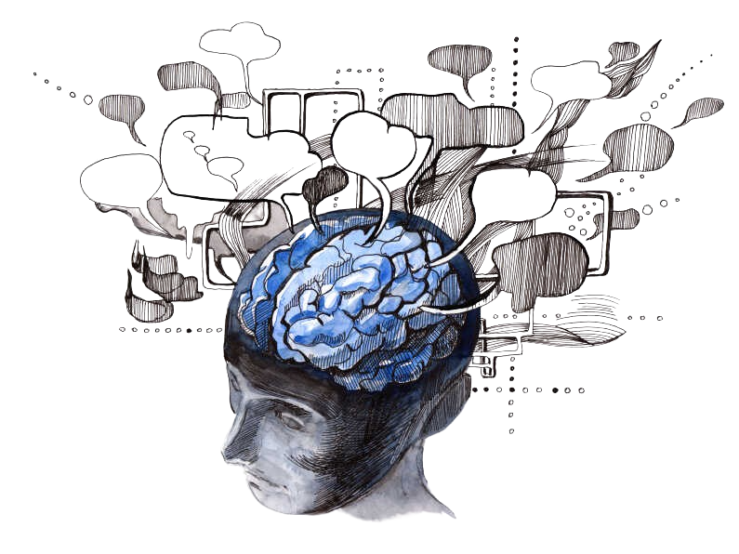
Ever Wondered?

Slide 3
What is Subconscious mind?
The subconscious mind exists in the mind but is not immediately available to consciousness : it affects thought, feeling, and behavior without our awareness.
The subconscious mind is not imaginary. It is very real, and an integral part of us.

Slide 4
Conscious vs Subconscious
The conscious level of awareness is what we obviously know, think or intend to act on at any given moment.
The subconscious contains many years of experiences, memories, habits and principles that guide and influence us.
Throughout your life, you have programmed your subconscious with thoughts that you have repeated to yourself to become habits.
The subconscious mind stores information and it stores the information for later retrieval when ”recalled” by the conscious mind. The subconscious mind is like the software that will obey any command you give it.

Slide 5
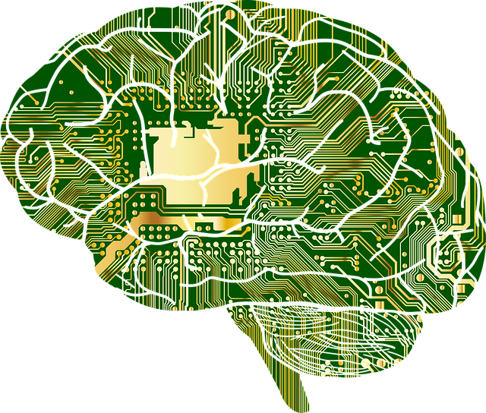
The conscious mind is the programmer. It’s the thinking mind, the creative mind. However… the conscious mind is influenced by filters that your predominant thoughts have created and stored in the subconscious.
The subconscious mind, does not judge or discriminate between what can and cannot be achieved or obtained.

Slide 6
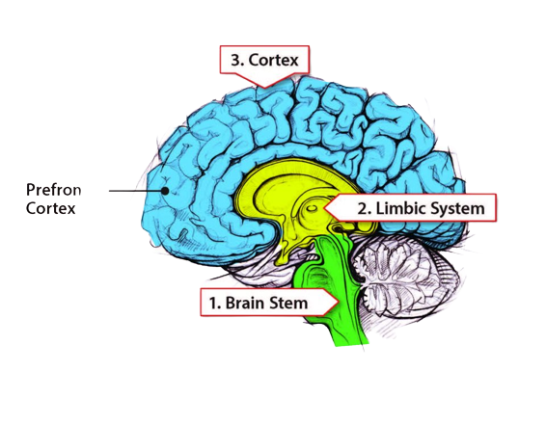
Where is the Subconscious Mind?!
The cortex is the conscious part (responsible for logical thinking) of the brain.
The limbic system is involved in regulating emotions, fight or flight responses, motivations and habits.
The limbic system is what we call our subconscious mind (responsible for our feelings).

Slide 7
Small, but not very small!
Although the Subconscious mind is very small, it makes up around 95% of your brain power and handles everything your body needs to function properly, from eating and breathing to digesting and making memories.

Slide 8
How is it possible?
For tonic water to cause a group of Students to become intoxicated in an experiment by psychologists Assefi and Garry.
For 44 hotel maids to acquire health benefits in another experiment by psychologists at Harvard?

Slide 9
The Answer lies in Subconscious mind, specifically in subconscious beliefs.
Subconscious mind incorporates all involuntary processes & functions including thoughts, beliefs, emotions, memories, skills and behaviours that are generated by and occur in the living brain and body and which we are unaware of.
So What are Subconscious belief then? Subconscious beliefs are instructions which are coded and stored in the cells of the nervous system and body as to how we should feel , act or behave or how our lives should run or operate.

Slide 10
Limiting Beliefs
Limiting Beliefs that are disempowering, self-destructive beliefs.
Common limiting beliefs include beliefs of hopelessness, powerlessness and worthlessness.
The Latter is particularly common with many people believing that they are not worthy of achieving whatever they want to achieve such as resolving a problem.
Belief controls the perception or feelings of the tissues and how their DNA is selected and expressed. Thus, Belief Determine gene selection, expression & behaviour i.e. our beliefs determine which gene we select and how those genes are expressed.
“Whether you believe you can or you believe you can’t, either way you’re right!”

Slide 11
How the Subconscious Mind controls our body
While you are awake or sound asleep upon your bed, the ceaseless, tireless action of your subconscious mind controls all the vital functions of your body without the help of your conscious mind.
For example: Heart beats, Inhalation and Exhalation, Hair grows whether you are asleep or awake.
For instance, many of our great scientists have received answers to perplexing problems while they were asleep. They saw the answers in a dream.

Slide 12
150,000
Big numbers catch your audience’s attention

Slide 13
9h 55m 23s
333,000
386,000 km
Jupiter's rotation period
The Sun’s mass compared to Earth’s
Distance between Earth and the Moon

Slide 14
SOME PERCENTAGES
25%
75%
VENUS
JUPITER
Venus is the second planet from the Sun
It’s the biggest planet in the Solar System

Slide 15
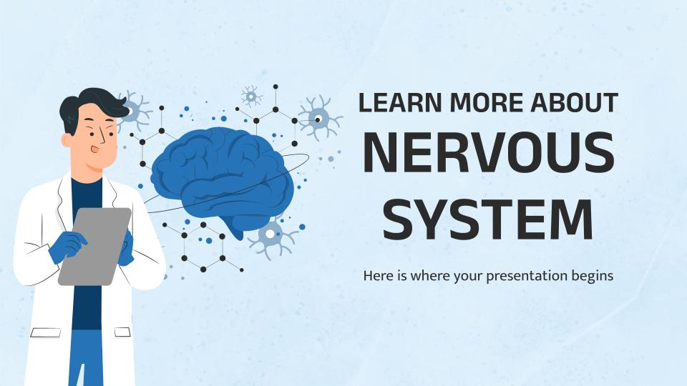
COMPUTER MOCKUP
You can replace the image on the screen with your own work. Just right-click on it and select “Replace image”

Slide 16

TABLET MOCKUP
You can replace the image on the screen with your own work. Just right-click on it and select “Replace image”

Slide 17
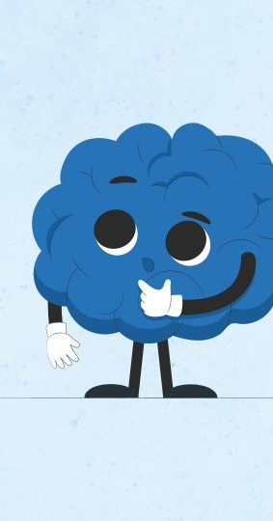
PHONE MOCKUP
You can replace the image on the screen with your own work. Just right-click on it and select “Replace image”

Slide 18
MAP
MERCURY
Mercury is the closest planet to the Sun and the smallest of them all
VENUS
Venus has a beautiful name and is the second planet from the Sun

Slide 19
NERVOUS SYSTEM TIMELINE
01
MERCURY
03
NEPTUNE
Mercury is the closest planet to the Sun and the smallest of them all
Neptune is the fourth-largest planet
in the Solar System
02
VENUS
04
JUPITER
Venus has a beautiful name and is the second planet from the Sun
Jupiter is a gas giant and the biggest planet in the Solar System

Slide 20
NERVOUS SYSTEM INFOGRAPHIC
04
MERCURY
JUPITER
01
It’s the closest planet to the Sun
Jupiter is the biggest planet of them all
05
VENUS
SATURN
02
Venus is the second planet from the Sun
Saturn was named after a Roman god
06
MARS
NEPTUNE
03
Mars is actually a very cold place
Neptune is far away from Earth

Slide 21
NERVOUS SYSTEM VOCABULARY
WORDS | DEFINITIONS
NERVOUS | Mercury is the closest planet to the Sun and the smallest of them all
BRAIN | Venus has a beautiful name and is the second planet from the Sun
NERVES | Despite being red, Mars is actually a very cold place
BRAINSTEM | Jupiter is a gas giant and the biggest planet in the Solar System

Slide 22
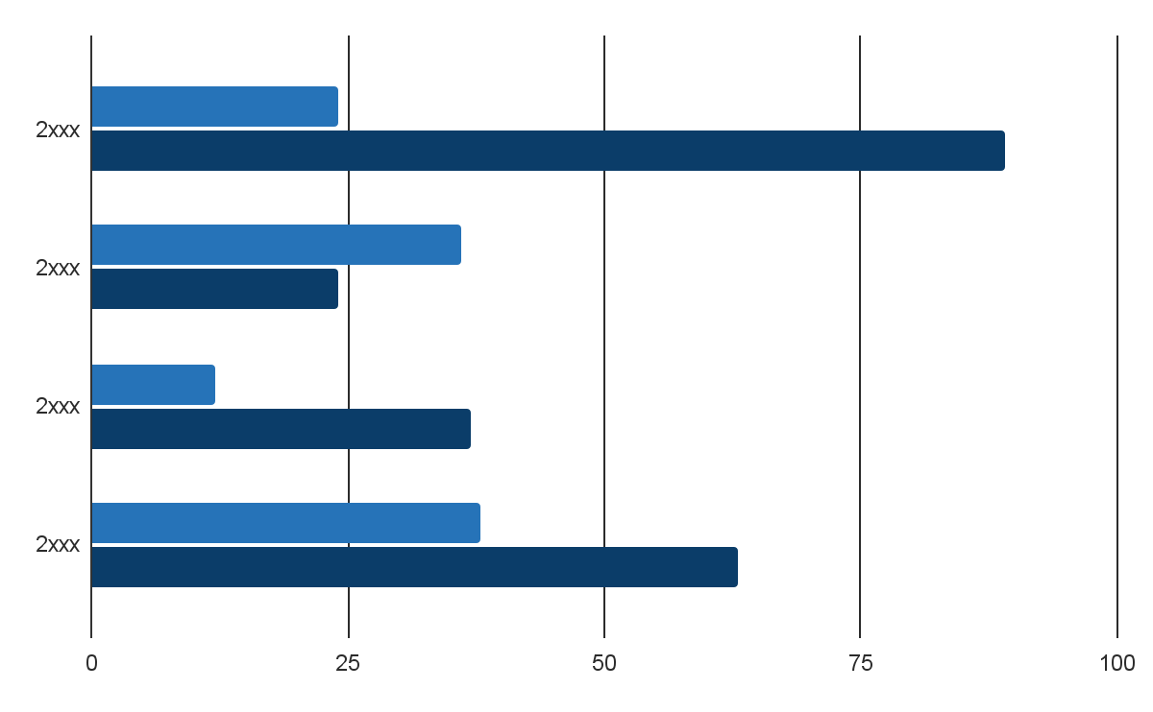
THIS IS A GRAPH
MERCURY
Mercury is the closest planet to the Sun and the smallest of them all
VENUS
Venus has a beautiful name and is the second planet from the Sun
Follow the link in the graph to modify its data and then paste the new one here. For more info, click here

Slide 23
FACTS ABOUT THE NERVOUS SYSTEM
Venus has a beautiful name and is the second planet from the Sun. It’s terribly hot, even hotter than Mercury, and its atmosphere is extremely poisonous
Mercury is the closest planet to the Sun and the smallest one in the Solar System—it’s only a bit larger than the Moon
Earth is the third planet from the Sun and the only one that harbors life in the Solar System. All humans live on this planet
Jupiter is a gas giant and the biggest planet in the Solar System. It's the fourth-brightest object in the night sky. It was named after the Roman god of the skies and lightning
Saturn is a gas giant and has several rings. It's composed mostly of hydrogen and helium. It was named after the Roman god of wealth and agriculture
Neptune is the farthest planet from the Sun. It's also the fourth-largest planet by diameter in the Solar System

Slide 24



OUR TEAM
SUSAN BONES
TIMMY JIMMY
JENNA DOE
You can speak a bit about this person here
You can speak a bit about this person here
You can speak a bit about this person here

Slide 25
THANKS!
Do you have any questions?
youremail@freepik.com
+91 620 421 838
yourwebsite.com
Please keep this slide for attribution

Slide 26
ALTERNATIVE RESOURCES
Here’s an assortment of alternative resources whose style fits the one of this template:
Chemist concept illustration
Mental health concept illustration

